Slide 1


CMPE 180-92 Data Structures and Algorithms in C++ March 9 Class Meeting
Department of Computer Engineering San Jose State University Spring 2017 Instructor: Ron Mak
www.cs.sjsu.edu/~mak

Slide 2
Assignment #6 Sample Solution
class Employee
{
public:
// Constructors and the destructor.
Employee();
Employee(int id, string last, string first, double salary);
~Employee();
// Getters.
int get_id() const;
string get_last() const;
string get_first() const;
double get_salary() const;
// Overloaded stream I/O operators.
friend ostream& operator <<(ostream& outs, const Employee& emp);
friend istream& operator >>(istream& ins, Employee& emp);
private:
int id;
string last; // first name
string first; // last name
double salary;
};
Employee.h

Slide 3
Assignment #6 Sample Solution, cont’d
Employee::Employee()
: id(0), last(""), first(""), salary(0)
{}
/**
* Constructor.
*/
Employee::Employee(int id, string last, string first, double salary)
: id(id), last(last), first(first), salary(salary)
{}
/**
* Destructor.
*/
Employee::~Employee()
{}
int Employee::get_id() const { return id; }
string Employee::get_last() const { return last; }
string Employee::get_first() const { return first; }
double Employee::get_salary() const { return salary; }
Employee.cpp

Slide 4
Assignment #6 Sample Solution, cont’d
ostream& operator <<(ostream& outs, const Employee& emp)
{
outs << "Employee{ID=" << emp.id << ", last=" << emp.last
<< ", first=" << emp.first
<< ", salary=" << emp.salary << "}";
return outs;
}
Employee.cpp

Slide 5
Assignment #6 Sample Solution, cont’d
istream& operator >>(istream& ins, Employee& emp)
{
string str;
// Employee's ID.
getline(ins, str, ',');
emp.id = stoi(str);
// Employee's last and first names.
getline(ins, emp.last, ',');
getline(ins, emp.first, ',');
// Employee's salary.
getline(ins, str);
emp.salary = stod(str);
return ins;
}
Employee.cpp

Slide 6
Assignment #6 Sample Solution, cont’d
void execute(const char command,
istream &input, vector<Employee>& list);
int find(const int id, const vector<Employee>& list);
void print_all(const vector<Employee>& list);
void print_stats(const vector<Employee>& list);
// Input error codes.
enum ErrorCode {NO_ERROR, DUPLICATE, NOT_FOUND, INVALID_COMMAND};
ErrorCode insert(istream &input,
vector<Employee>& list, int& id, int &index);
ErrorCode get(istream &input,
vector<Employee>& list, int &id, int &index);
ErrorCode remove(istream &input, vector<Employee>& list, int &id,
Employee& employee);
ErrorCode invalid_command(istream &input, int& id);
const string INPUT_FILE_NAME = "commands.in";
EmployeeApp.cpp

Slide 7
Assignment #6 Sample Solution, cont’d
int main()
{
// Open the input file.
ifstream input;
input.open(INPUT_FILE_NAME);
if (input.fail())
{
cout << "Failed to open " << INPUT_FILE_NAME << endl;
return -1;
}
vector<Employee> list; // vector of employee records (objects)
char command;
input >> command; // read the first command
EmployeeApp.cpp

Slide 8
Assignment #6 Sample Solution, cont’d
while (!input.eof())
{
cout << command << " ";
execute(command, input, list); // execute the current command
input >> command; // read the next command
}
print_all(list);
print_stats(list);
return 0;
}
EmployeeApp.cpp

Slide 9
Assignment #6 Sample Solution, cont’d
void execute(const char command, istream &input, vector<Employee>& list)
{
int id, index;
ErrorCode error_code;
Employee employee;
// Execute the command.
switch (command)
{
case '+':
error_code = insert(input, list, id, index);
employee = list[index];
break;
case '-':
error_code = remove(input, list, id, employee);
break;
case '?':
error_code = get(input, list, id, index);
if (error_code == NO_ERROR) employee = list[index];
break;
default:
error_code = invalid_command(input, id);
break;
}
EmployeeApp.cpp

Slide 10
Assignment #6 Sample Solution, cont’d
cout << id << ": "; // ID of the employee the command operated on
// Output any error message.
switch (error_code)
{
case DUPLICATE:
cout << "*** Duplicate ID ***";
break;
case NOT_FOUND:
cout << "*** ID not found ***";
break;
case INVALID_COMMAND:
cout << "*** Invalid command ***";
break;
default:
cout << employee; // No error: Output the employee record.
break;
}
cout << endl;
}
EmployeeApp.cpp

Slide 11
Assignment #6 Sample Solution, cont’d
int find(const int id, const vector<Employee>& list)
{
// Do a linear search.
for (int i = 0; i < list.size(); i++)
{
Employee emp = list[i];
if (id == emp.get_id()) return i; // found
}
return -1; // not found
}
EmployeeApp.cpp

Slide 12
Assignment #6 Sample Solution, cont’d
void print_all(const vector<Employee>& list)
{
cout << endl;
cout << "All employees" << endl;
cout << "-------------" << endl;
// Output each employee record in the vector.
for (Employee emp : list) cout << emp << endl;
}
EmployeeApp.cpp

Slide 13
Assignment #6 Sample Solution, cont’d
void print_stats(const vector<Employee>& list)
{
int size = list.size();
if (size == 0) return; // no stats if no employee records
// Initialize the min, max, and total salary
// using the first employee record.
double min, max, total;
min = max = total = list[0].get_salary();
// Loop over the rest of the vector
// to compute the min, max, and total salary.
for (int i = 1; i < size; i++)
{
double salary = list[i].get_salary();
if (salary < min) min = salary;
if (salary > max) max = salary;
total += salary;
}
EmployeeApp.cpp

Slide 14
Assignment #6 Sample Solution, cont’d
cout << endl;
cout << "Statistics" << endl;
cout << "----------" << endl;
cout.setf(ios::fixed);
cout.precision(2);
cout << "Minimum salary = $" << setw(9) << min << endl;
cout << "Maximum salary = $" << setw(9) << max << endl;
cout << "Average salary = $" << setw(9) << total/list.size()
<< endl;
}
EmployeeApp.cpp

Slide 15
Assignment #6 Sample Solution, cont’d
/**
* Read a new employee record and insert it into the employee vector
* at the appropriate position to maintain sort order.
* @param istream the input data stream.
* @param list the vector of employee records.
* @param id set to the employee ID of the new record.
* @param index set to the vector index of the new record.
* @return the error code of this operation.
*/
ErrorCode insert(istream &input, vector<Employee>& list,
int &id, int& index)
{
// Read the employee record.
Employee employee;
input >> employee;
id = employee.get_id();
EmployeeApp.cpp

Slide 16
Assignment #6 Sample Solution, cont’d
// First insertion into an empty vector?
if (list.size() == 0)
{
list.push_back(employee);
index = 0;
return NO_ERROR;
}
// Loop to find the proper insertion position.
index = 0;
while ((index < list.size()) &&
(id > list[index].get_id())) index++;
// Is it a duplicate employee ID?
if (id == list[index].get_id()) return DUPLICATE;
// Insert.
list.insert(list.begin() + index, employee);
return NO_ERROR;
}
EmployeeApp.cpp

Slide 17
Assignment #6 Sample Solution, cont’d
/**
* Get the vector index of employee record with the given employee ID.
* @param istream the input data stream.
* @param list the vector of employee records.
* @param id set to the employee ID of the new record.
* @param index set to the vector index of the new record.
* @return the error code of this operation.
*/
ErrorCode get(istream &input, vector<Employee>& list,
int &id, int& index)
{
input >> id;
// Look for the employee record with a matching ID.
index = find(id, list);
if (index == -1) return NOT_FOUND;
// Found the employee record.
return NO_ERROR;
}
EmployeeApp.cpp

Slide 18
Assignment #6 Sample Solution, cont’d
/**
* Remove an employee record from the employee vector.
* @param istream the input data stream.
* @param list the vector of employee records.
* @param id set to the employee ID of the new record.
* @param employee set to the removed employee.
* @return the error code of this operation.
*/
ErrorCode remove(istream &input, vector<Employee>& list, int &id,
Employee& employee)
{
input >> id;
// Look for the employee record with a matching ID.
int index = find(id, list);
if (index == -1) return NOT_FOUND;
// Remove the matching record from the vector.
employee = list[index];
list.erase(list.begin() + index);
return NO_ERROR;
}
EmployeeApp.cpp

Slide 19
Assignment #6 Sample Solution, cont’d
/**
* Process an invalid command.
* @param istream the input data stream.
* @param id set to the employee ID of the new record.
* @return the error code.
*/
ErrorCode invalid_command(istream &input, int& id)
{
input >> id;
// Read and ignore the rest of the input line.
string ignore;
getline(input, ignore);
return INVALID_COMMAND;
}
EmployeeApp.cpp

Slide 20
A “Safe” Array Type: Version 1
We will develop a new array type that is “safe”.
It will allocate the array dynamically.
It will check all subscript values to ensure that they are in the legal range (0 ≤ index < array length).
We’ll start with an integer array.

Slide 21
A “Safe” Array Type: Version 1, cont’d
SafeArray1.h
class SafeArray
{
public:
SafeArray();
SafeArray(int len);
~SafeArray();
int get_length() const;
int at(int i) const;
void set(int i, int value);
void operator =(const SafeArray& rhs);
private:
int *elements;
int length;
};

Slide 22
A “Safe” Array Type: Version 1, cont’d
SafeArray1.cpp
SafeArray::SafeArray() : elements(nullptr), length(0)
{
}
SafeArray::SafeArray(int len) : elements(nullptr), length(len)
{
elements = new int[length];
}
SafeArray::~SafeArray()
{
if (elements != nullptr) delete[] elements;
}
int SafeArray::get_length() const { return length; }
int SafeArray::at(int i) const
{
assert((i >= 0) && (i < length));
return elements[i];
}

Slide 23
A “Safe” Array Type: Version 1, cont’d
SafeArray.cpp
void SafeArray::set(int i, int value)
{
assert((i >= 0) && (i < length));
elements[i] = value;
}
void SafeArray::operator =(const SafeArray& rhs)
{
if (elements != nullptr) delete[] elements;
length = rhs.length;
elements = new int[length];
for (int i = 0; i < length; i++)
{
elements[i] = rhs.elements[i];
}
}

Slide 24
A “Safe” Array Type: Version 1, cont’d
SafeArrayTests1.cpp
int main()
{
SafeArray a1(10), a2;
//SafeArray a3;
for (int i = 0; i < 10; i++) a1.set(i, 10*i);
a2 = a1;
a1.set(4, -a1.at(4));
cout << "a1 ="; print(a1);
cout << "a2 ="; print(a2);
//a3 = a2 = a1;
return 0;
}
void print(SafeArray& a)
{
for (int i = 0; i < a.get_length(); i++) cout << " " << a.at(i);
cout << endl;
}
a1 = 0 10 20 30 -40 50 60 70 80 90
a2 = 0 10 20 30 40 50 60 70 80 90

Slide 25
A “Safe” Array Type: Version 1, cont’d
What happens if you try to chain assignments?
SafeArray a1(10), a2;
SafeArray a3;
...
a3 = a2 = a1;
../SafeArrayTests.cpp:20:8: error: no viable overloaded '='
a3 = a2 = a1;
~~ ^ ~~~~~~~
../SafeArray.h:16:10: note: candidate function not viable: cannot convert argument of incomplete type 'void' to 'const SafeArray'
void operator =(const SafeArray& rhs);
^
1 error generated.

Slide 26
A “Safe” Array Type: Version 2
SafeArray2.h
class SafeArray
{
public:
SafeArray();
SafeArray(int len);
~SafeArray();
int get_length() const;
int at(int i) const;
void set(int i, int value);
SafeArray& operator =(const SafeArray& rhs);
private:
int *elements;
int length;
};

Slide 27
A “Safe” Array Type: Version 2, cont’d
SafeArray& SafeArray::operator =(const SafeArray& rhs)
{
if (elements != nullptr) delete[] elements;
length = rhs.length;
elements = new int[length];
for (int i = 0; i < length; i++)
{
elements[i] = rhs.elements[i];
}
return *this;
}
SafeArray2.cpp

Slide 28
A “Safe” Array Type: Version 2, cont’d
SafeArrayTests2.cpp
int main()
{
SafeArray a1(10), a2, a3;
for (int i = 0; i < 10; i++) a1.set(i, 10*i);
a3 = a2 = a1;
a1.set(4, -a1.at(4));
cout << "a1 ="; print(a1);
cout << "a2 ="; print(a2);
cout << "a3 ="; print(a3);
return 0;
}
a1 = 0 10 20 30 -40 50 60 70 80 90
a2 = 0 10 20 30 40 50 60 70 80 90
a3 = 0 10 20 30 40 50 60 70 80 90

Slide 29
A “Safe” Array Type: Version 2, cont’d
What happens the program executes
a1 = a1;
SafeArray& SafeArray::operator =(const SafeArray& rhs)
{
if (elements != nullptr) delete[] elements;
length = rhs.length;
elements = new int[length];
for (int i = 0; i < length; i++)
{
elements[i] = rhs.elements[i];
}
return *this;
}
SafeArray2.cpp

Slide 30
A “Safe” Array Type: Version 3
The solution:
SafeArray& SafeArray::operator =(const SafeArray& rhs)
{
if (this == &rhs) return *this;
if (elements != nullptr) delete[] elements;
length = rhs.length;
elements = new int[length];
for (int i = 0; i < length; i++)
{
elements[i] = rhs.elements[i];
}
return *this;
}
SafeArray3.cpp

Slide 31
Break

Slide 32
A “Safe” Array Type: Version 4
The at and set member functions are awkward to use.
Why can’t we use subscripts on a smart array as if it were a regular array?
We can overload the subscript operator []
We want the subscripts to be usable on either side of an assignment.
Example:
a1[4] = -a1[4];

Slide 33
A “Safe” Array Type: Version 4, cont’d
class SafeArray
{
public:
SafeArray();
SafeArray(int len);
~SafeArray();
int get_length() const;
int at(int i) const;
void set(int i, int value);
SafeArray& operator =(const SafeArray& rhs);
int& operator [](int i) const;
private:
int *elements;
int length;
};
SafeArray4.h

Slide 34
A “Safe” Array Type: Version 4, cont’d
int& SafeArray::operator [](int i) const
{
assert((i >= 0) && (i < length));
return elements[i];
}
SafeArray4.cpp

Slide 35
A “Safe” Array Type: Version 4, cont’d
int main()
{
SafeArray a1(10), a2, a3;
for (int i = 0; i < 10; i++) a1[i] = 10*i;
a3 = a2 = a1;
a1[4] = -a1[4];
cout << "a1 ="; print(a1);
cout << "a2 ="; print(a2);
cout << "a3 ="; print(a3);
return 0;
}
void print(SafeArray& a)
{
for (int i = 0; i < a.get_length(); i++) cout << " " << a[i];
cout << endl;
}
SafeArrayTests4.cpp
a1 = 0 10 20 30 -40 50 60 70 80 90
a2 = 0 10 20 30 40 50 60 70 80 90
a3 = 0 10 20 30 40 50 60 70 80 90

Slide 36
A “Safe” Array Type: Version 4, cont’d
What if we passed the smart array object by value instead of by reference?
void print(SafeArray a)
{
for (int i = 0; i < a.get_length(); i++)
{
cout << " " << a[i];
}
cout << endl;
}
SafeArrayTests4.cpp
a1 = 0 10 20 30 -40 50 60 70 80 90
a2 = 0 10 20 30 40 50 60 70 80 90
a3 = 0 10 20 30 40 50 60 70 80 90
SafeArray4(78650,0x7fffbe7fe3c0) malloc: *** error for object 0x7fbe64c02740:
pointer being freed was not allocated
*** set a breakpoint in malloc_error_break to debug

Slide 37
A “Safe” Array Type: Version 5
A very unexpected side effect!
At the end, the program attempted to delete the private dynamic array elements.
But the dynamic array was already deleted by the destructor.
So who tried to delete the array again?
Why did passing a SmartArray object by value instead of by reference to the print function cause this problem?

Slide 38
A “Safe” Array Type: Version 5, cont’d
When a SmartArray object is passed by value to the print function, a copy is made.
This copy will point to the same dynamic array.
This is what the default copy constructor does.
a1 (main)
elements
a (function)
elements

Slide 39
A “Safe” Array Type: Version 5, cont’d
When the print function completes and returns, its local variables go out of scope.
The SmartArray object’s destructor is called, which deletes the dynamic array.
Now variable a1 has a dangling pointer.
When the program is ready to terminate, it calls a1’s destructor.
An error occurs because of the attempt to delete memory that has already been deleted.
a1 (main)
elements
a (function)
elements

Slide 40
Copy Constructor
Every class has a copy constructor.
C++ supplies a default copy constructor.
It may not do what you want, so you can write one.
A copy constructor has only one parameter, which is a reference to the same class.
A copy constructor is called when:
A new object is created and initialized using another object of the same type.
An object is passed by value to a function.
An object is returned by a function.

Slide 41
A “Safe” Array Type: Version 5, cont’d
SafeArray5.h
class SafeArray
{
public:
SafeArray();
SafeArray(int len);
SafeArray(const SafeArray& other); // copy constructor
~SafeArray();
int get_length() const;
SafeArray& operator =(const SafeArray& rhs);
int& operator [](int i) const;
private:
int *elements;
int length;
};

Slide 42
A “Safe” Array Type: Version 5, cont’d
SafeArray::SafeArray(const SafeArray& other)
: elements(nullptr), length(0)
{
length = other.length;
elements = new int[length];
for (int i = 0; i < length; i++)
{
elements[i] = other.elements[i];
}
}
SafeArray5.cpp
Now the copy of the object has a separate copy of the contents of the elements array.

Slide 43
Shorthand for Pointer Expressions
class Node
{
public:
Node(int value);
~Node();
int data;
Node *next;
};
Node *head;
The expression head->data is the preferred shorthand for (*head).data

Slide 44
Searching a Sorted Linked List
Node *SortedLinkedList::find(int value) const
{
Node *p = head;
// Search the sorted list.
while ((p != nullptr) && (value > p->data)) p = p->next;
if ((p != nullptr) && (value == p->data)) return p; // found
else return nullptr; // not found
}
Search for 20:
Search for 25:
head
10
20
30
Found!
p
head
10
20
30
Not found!
p

Slide 45
Inserting into a Sorted Linked List
Insert the first element into a sorted linked list.
if (head == nullptr)
{
head = new_node;
return new_node;
}
head
10
new_node

Slide 46
Inserting into a Sorted Linked List, cont’d
Insert at the beginning of an existing sorted linked list.
else if (value < head->data)
{
new_node->next = head;
head = new_node;
return new_node;
}
head
10
20
30
5
new_node

Slide 47
Inserting into a Sorted Linked List, cont’d
Insert into the middle of a sorted linked list.
while ((p != nullptr) && (value >= p->data))
{
prev = p;
p = p->next;
}
prev->next = new_node;
new_node->next = p;
return new_node;
head
10
20
30
prev
p
25
new_node

Slide 48
Removing from a Sorted Linked List
Remove from the head of a sorted list.
if (value == head->data)
{
Node *next = head->next;
delete head;
head = next;
return;
}
head
10
20
30
next

Slide 49
Removing from a Sorted Linked List, cont’d
Remove from the middle of a sorted list.
while ((p != nullptr) && (value > p->data))
{
prev = p;
p = p->next;
}
if ((p != nullptr) && (value == p->data))
{
Node *next = p->next;
delete p;
prev->next = next;
}
head
10
20
30
prev
p
next

Slide 50
Linked List Tail
Often there are advantages for a linked list to maintain both a head pointer and a tail pointer.
tail
head
10
20
30

Slide 51
Queue
A queue is a data structure which you can insert objects into and from which you can remove objects.
The queue maintains the order that the objects are inserted.
Objects are removed from the queue in the same order that they were inserted.
This is commonly known as first-in first-out (FIFO).

Slide 52
Queue, cont’d
We can use a linked list to implement a queue.
Insert new objects at the head.
Remove objects at the tail.
Objects in the queue are in arrival order.
Not necessary for the objects to be in data order.
Insert an
object here.
tail
head
Remove an
object here.

Slide 53
Stack
A stack is a data structure which you can insert objects into and from which you can remove objects.
The stack maintains the order that the objects are inserted.
Objects are removed from the queue in the reverse order that they were inserted.
This is commonly known as last-in first-out (LIFO).

Slide 54
Stack, cont’d
We can use a linked list to implement a stack.
Insert (push) new objects at the head.
Remove (pop) objects at the head.
Objects in the queue are in arrival order.
Not necessary for the objects to be in data order.
Insert an
object here.
Remove an
object here.
tail
head

Slide 55
Assignment #7
Practice with linked lists.
You will get an input file boundary.csv that contains the geographic coordinates of a series of points on the border of the continental U.S.
One point per line
Each point is in the form latitude, longitude
Example:
42.258373,-80.556416
41.99385,-124.184283
42.023529,-70.649609
41.311172,-72.335129
40.441448,-124.395634
40.280175,-124.282443
40.28276,-73.944546
39.916698,-123.94305

Slide 56
Assignment #7, cont’d
Read these point one at a time and insert them into a linked list that is sorted first by latitude and then by longitude.
Use the coordinates to print an outline of the continental U.S.
You will need to scale the geo coordinates to fit a page (or screen).

Slide 57
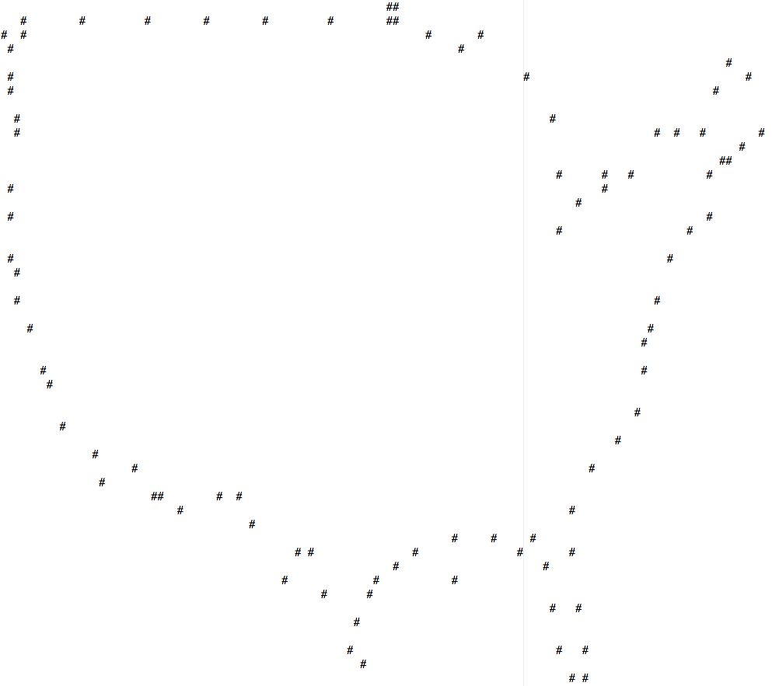
Assignment #7, cont’d

Slide 58
Assignment #7, cont’d
You will get another input file cities.csv where each line contains the name, state, and geo coordinates of a U.S. city.
Example:
Combine the city data with the border data to print a map of the U.S.
Phoenix,AZ,1428509,33.4483333
Tucson,AZ,518907,32.2216667
Mesa,AZ,449878,33.4222222
Los Angeles,CA,3877129,34.0522222
San Jose,CA,897460,37.3394444
San Francisco,CA,732072,37.775
Denver,CO,555981,39.7391667
Colorado Springs,CO,373072,38.8338889
Aurora,CO,299780,39.7294444

Slide 59
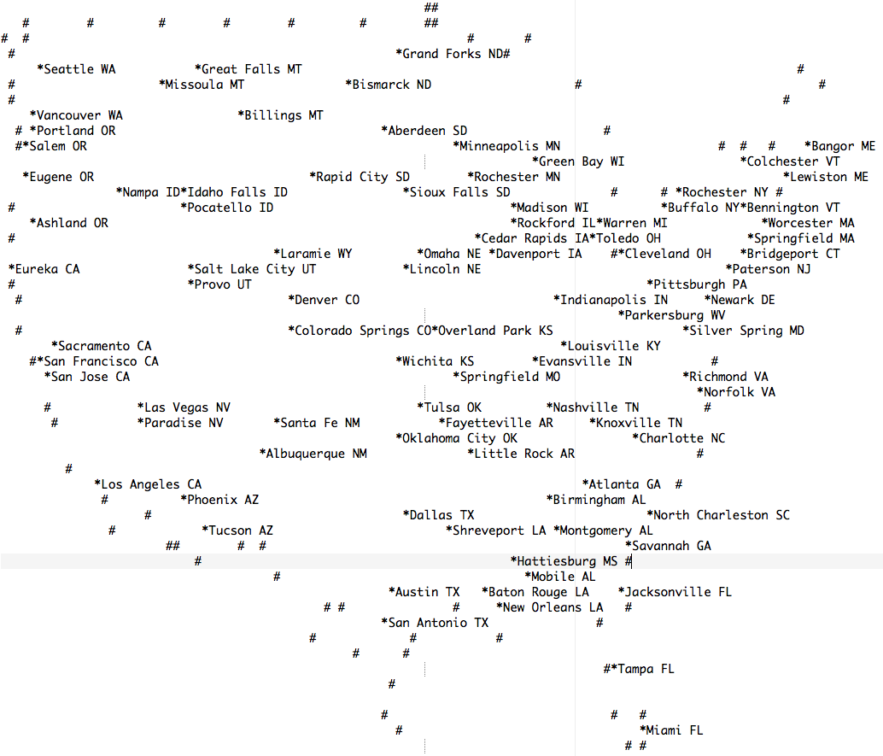
Assignment #7, cont’d

Slide 60
Namespaces
A namespace is a collection of identifiers.
Names of variables, functions, classes, etc.
When we use a namespace, it opens a scope for those identifiers.
In other words, we can use those names.
Example: Now we can use the names in the standard namespace.
using namespace std;

Slide 61
Namespaces, cont’d
When have separate compilations, different programmers can write different source files.
How do we ensure that names used by one programmer do not conflict with names used by another programmer?
Each programmer can define his or her own namespace and put names into it.

Slide 62
Namespaces, cont’d
namespace rons_namespace
{
void function foo();
...
}
If another programmer wants to use names defined in rons_namespace:
Use rons_namespace in subsequent code
using namespace rons_namespace;

Slide 63
Namespaces, cont’d
namespace rons_namespace
{
void function foo();
...
}
Use the scope resolution operator :: to use only a specific name from a namespace.
Example:
Also:
rons_namespace::foo();
using rons_namespace::foo;
...
foo();

Slide 64
Midterm Next Week
Combination of multiple-choice, short answer, and short programming (such as a function or a class declaration).
Covers
all lectures through today
Savitch book chapters 1 – 13
assignments 1 – 6
Closed book and laptop
75 minutes

